Slide 1
Cutting tools: materials and applications
Lecture 19

Slide 2
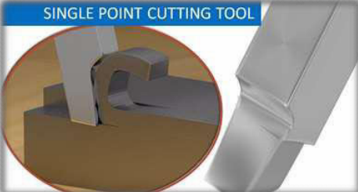
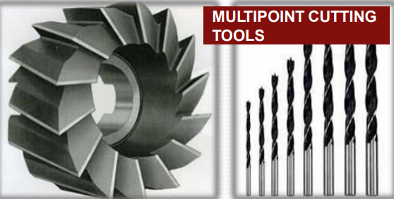
Introduction
Design of a single-point cutting tool is an important aspect of tool engineering. This unit deals with the design of the tool shank, the design of the single-point cutting tool, and various forces involved during the machining of the workpiece.
The strength and rigidity of the tool are also taken into account while designing a single-point cutting tool.

Slide 3
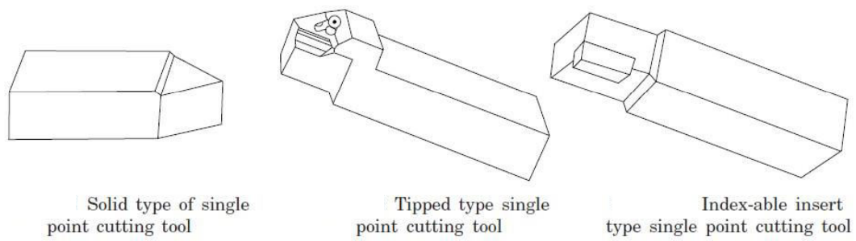
Introduction…
Cutting tools perform the main machining operation.
It is a body having teeth or cutting edges on it.
They comprise single-point cutting tools or multipoint cutting tools.
Single-point cutting tool: This type of tool features an effective cutting edge that removes excess material from the workpiece along its length. These tools may be left-handed or right-handed.

Slide 4
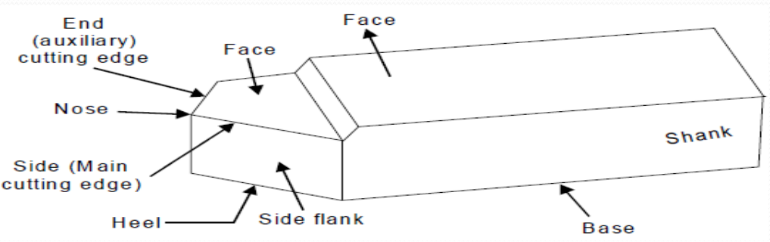
Cutting tool geometry
Geometry comprises mainly of nose, rake face of the tool, flank, heel and shank etc. The nose is shaped as conical with different angles.

Slide 5
Needs of cutting tool materials
To meet the growing demands for high productivity, quality, and economy of
machining
• To enable effective and efficient machining of the exotic materials that are coming
up with the rapid and vast progress of science and technology
For precision and ultra-precision machining
For micro and even nano machining demanded by the day and the future.
The capability and overall performance of the cutting tools depend upon,
• The cutting tool materials
• The cutting tool geometry
• Proper selection and use of those tools
• The machining conditions and the environments

Slide 6
Cutting-tool materials
Toolbits are generally made of seven materials
High-speed steel
Cast alloys
Cemented carbides
Ceramics
Cermets
Cubic Boron Nitride
Polycrystalline Diamond

Slide 7
Properties of cutting tool materials
1. Red hardness or Hot Hardness: It is the ability of a material to retain its hardness at high temperature
2. Wear resistance: It enables the cutting tool to retain its shape and cutting efficiency
3. Toughness: It relates to the ability of a material to resist shock or impact loads associated with interrupted cuts
Classification tool materials:
Carbon-Tool Steels:
➢ 0.6-1.5% carbon + little amount of Mn, Si, Cr, V to increase hardness.
➢ Low carbon varieties possess good toughness & shock resistance.
➢ High carbon varieties possess good abrasion resistance

Slide 8
2. High Speed Steels (HSS):
High carbon+ little amount Tungsten, Molybdenum, Cr, V & cobalt to increase
hardness, toughness, and wear resistance.
High operating temperatures up to 600 °C
Two types of HSS, i.e., T-type and M-type
Vanadium increases abrasion resistance, but a higher percentage will decrease grindability.
Chromium increases hardenability
Cobalt is added to HSS to increase red hardness.
3. Cast Cobalt Base Alloys:
It is a combination of W, Cr, carbon, and Cobalt which form an alloy with red hardness, wear resistance, and toughness. It is prepared by casting.
Used for machining Cast iron, alloy steels, non-ferrous metals, and super alloys

Slide 9
4. Cemented Carbides:
These are carbides of W, Titanium, and tantalum with a small amount of cobalt produced by means of the powder metallurgy route.
Two types, i.e, Straight Tungsten Carbide Cobalt Grade and Alloyed Tungsten Carbide Grade.
Alloyed Tungsten Carbide Grade: All grades of steel at 3 to 4 times faster than HSS
5. Ceramic Tools:
Aluminium Oxide, Silicon Carbide, Boron Carbide, Titanium Carbide, Titanium Boride
High speed, longer tool life, superior surface finish, and no coolant is required.

Slide 10
6. Diamond Tools:
More abrasion resistance
Used for turning grinding wheels
Used to produce a mirror surface finish.
Diamond abrasive belts are used to produce TV screens
Poly-crystalline diamond inserts are brazed into the cutting edges of circular saws for cutting construction materials like concrete, refractories, stone, etc.

Slide 11
Machinability
Mainly concerned with workpiece material properties, not the tool properties. It depends on workpiece material properties, and good machinability means:
1. Low tool wear
2. Good surface finish produced
3. Low cutting forces
Machinability is defined as “THE EASE WITH WHICH A GIVEN WORKPIECCE MATERIAL CAN BE MACHINED WITH A SPECIFIED CUTTING TOOL.

Slide 12
Machinability…
Ease of machining or machinability characteristics of any tool-work pair is
to be judged by :
• magnitude of the cutting forces
• tool wear or tool life
• surface finish
• magnitude of cutting temperature
• chip forms
• Machinability will be considered desirably high when cutting forces, temperature, surface roughness, and tool wear are less, tool life is long, and chips are ideally uniform and short, enabling short chip-tool contact length and less friction.

Slide 13
Role of the properties of the work material on machinability
The work material properties that generally govern machinability to a varying extent are:
the basic nature – brittleness or ductility, etc.
microstructure
mechanical strength – fracture or yield
hardness
hot strength and hot hardness
work hardenability
thermal conductivity
chemical reactivity
stickiness / self-lubricity

Slide 14
Role of the properties of the work material on machinability
The work material properties that generally govern machinability to a varying extent are:
the basic nature – brittleness or ductility, etc.
microstructure
mechanical strength – fracture or yield
hardness
hot strength and hot hardness
work hardenability
thermal conductivity
chemical reactivity
stickiness / self-lubricity

Slide 15
Applications of cutting tool materials
Plain Carbon Steels: For cutting tools such as hand taps, threading dies, saws, etc.
High-speed steels: General-purpose tools like drills, milling cutters, broaches, etc.
Cast alloy: For a range of applications intermediate between high-speed steel and carbides
Carbides: For applications employing higher cutting speeds on machine tools having sufficient power.
Ceramics: For applications where the rigidity of the machine tool, tooling, and workpiece is extremely high and the workpiece configuration does not cause interrupted cutting.
Diamond tools: High volume production of precision components, where surface finish, geometrical, and dimensional accuracies is very high.

